Slide 1
How to Crack MS-Word Password

Slide 2
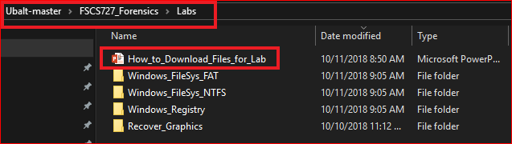
Following the PPTs to download required files for the lab

Slide 3
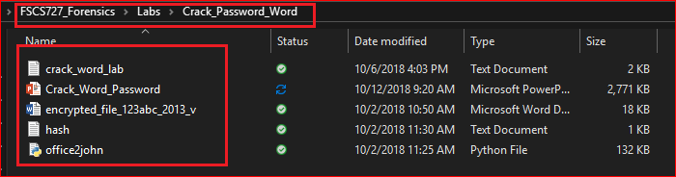
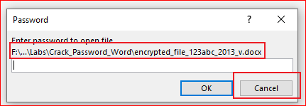
Verify the required files
Try to open the Word file

Slide 4
We are going to find the password!

Slide 5
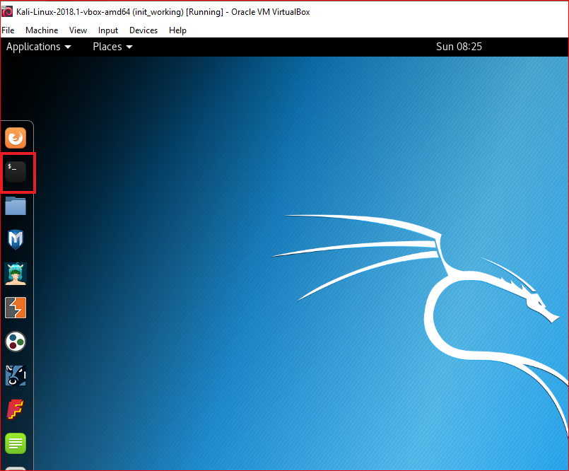
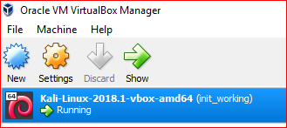

Slide 6
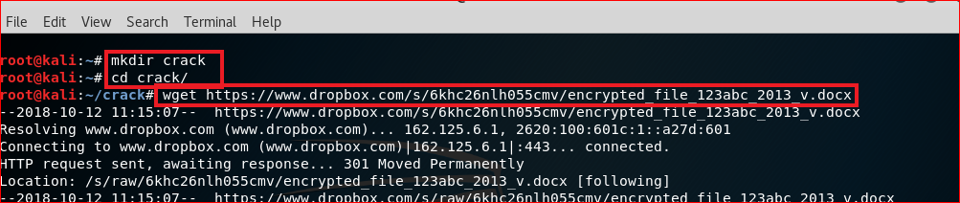
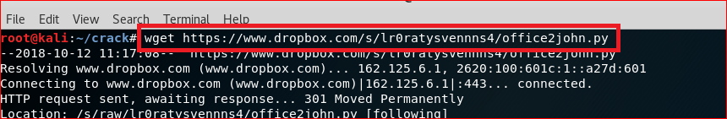
Download files
wget https://www.dropbox.com/s/6khc26nlh055cmv/encrypted_file_123abc_2013_v.docx
wget https://www.dropbox.com/s/lr0ratysvennns4/office2john.py

Slide 7
Extract Hash code of an encrypted Word file

Slide 8
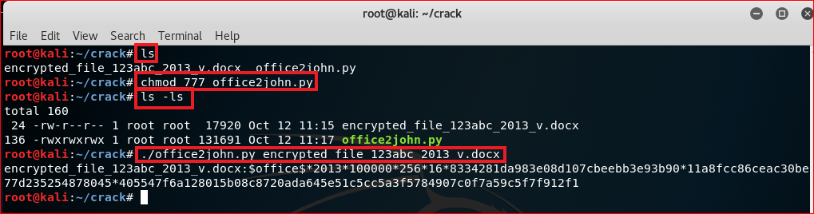
encrypted_file_123abc_2013_v.docx:$office$*2013*100000*256*16*8334281da983e08d107cbeebb3e93b90*11a8fcc86ceac30be77d235254878045*405547f6a128015b08c8720ada645e51c5cc5a3f5784907c0f7a59c5f7f912f1

Slide 9
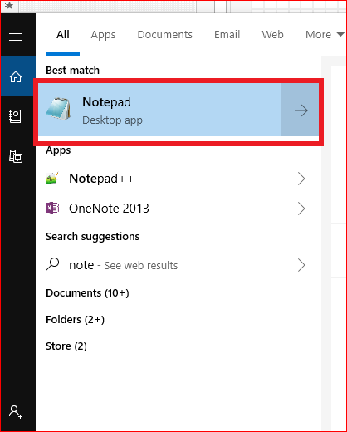
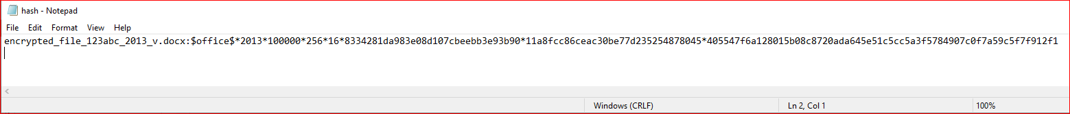
Copy the paste the hash code to hash.txt
encrypted_file_123abc_2013_v.docx:$office$*2013*100000*256*16*8334281da983e08d107cbeebb3e93b90*11a8fcc86ceac30be77d235254878045*405547f6a128015b08c8720ada645e51c5cc5a3f5784907c0f7a59c5f7f912f1

Slide 10
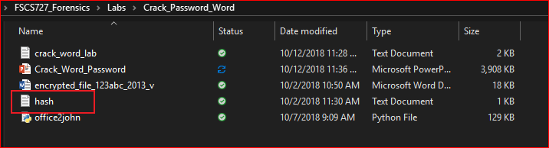
Verify

Slide 11
Install crack software

Slide 12
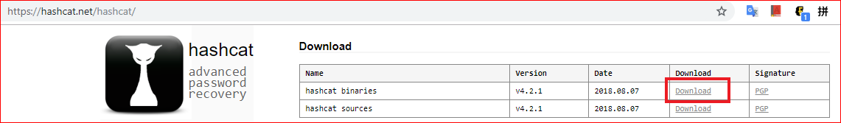
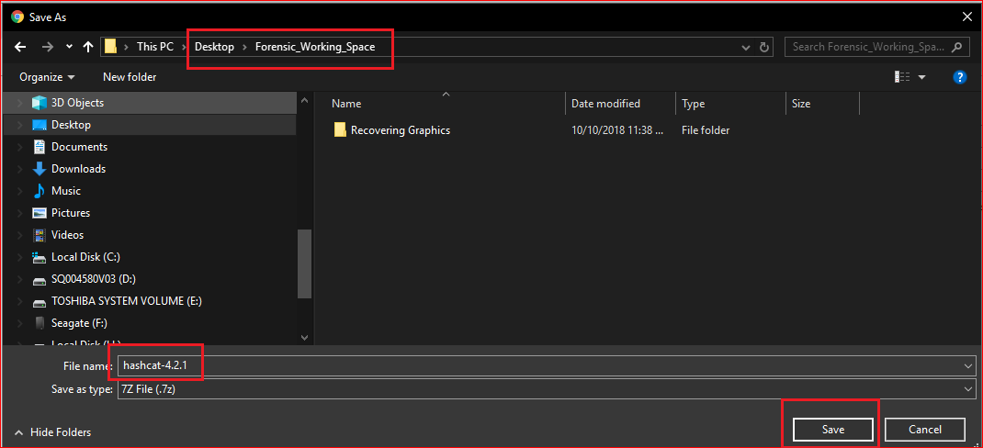
https://hashcat.net/hashcat/

Slide 13
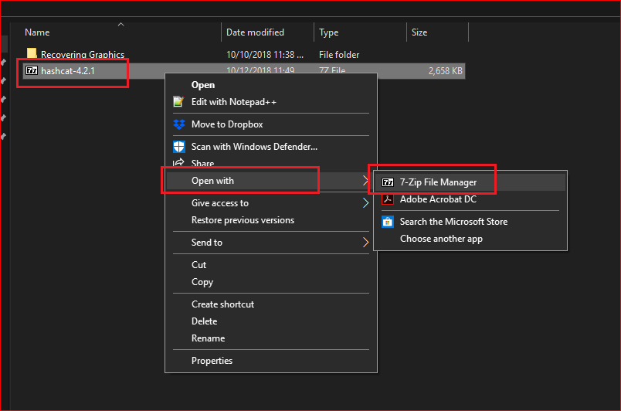

Slide 14
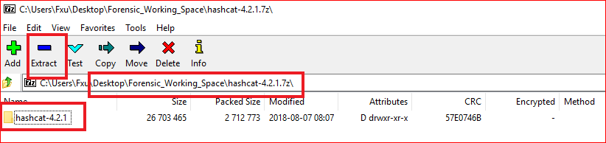
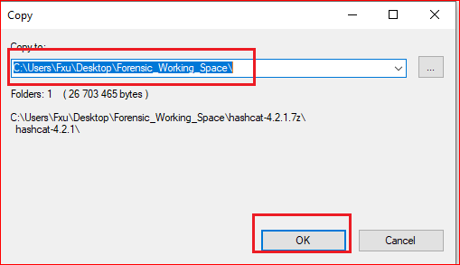

Slide 15
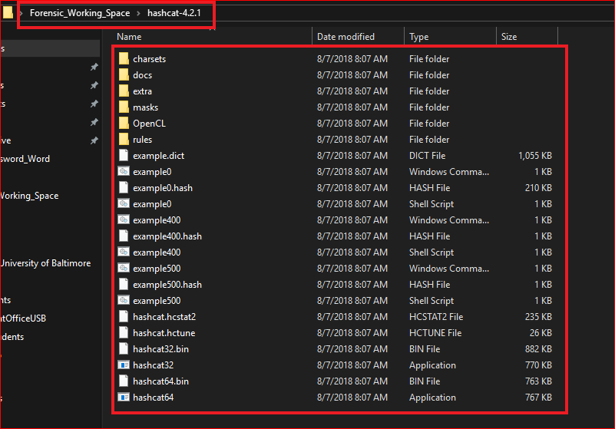

Slide 16
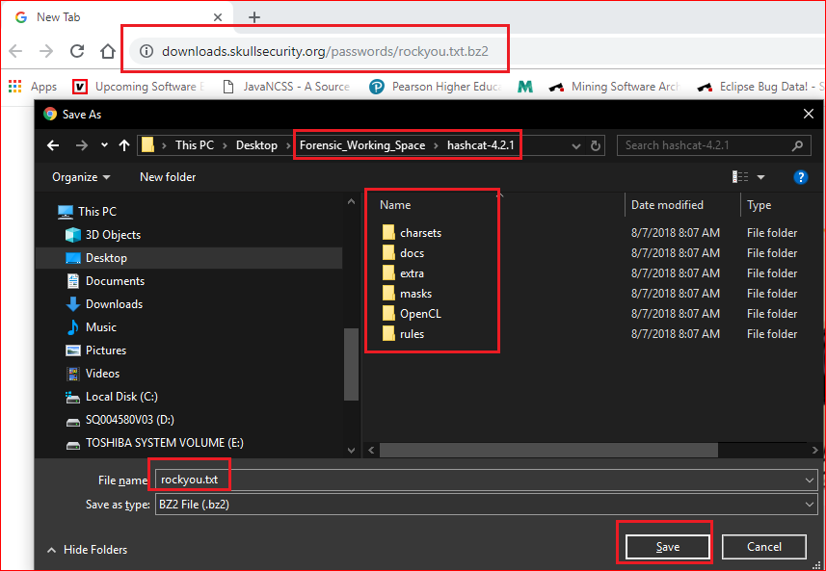

Slide 17
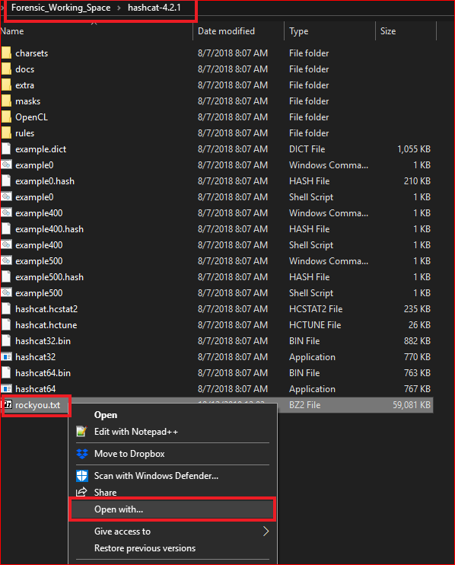
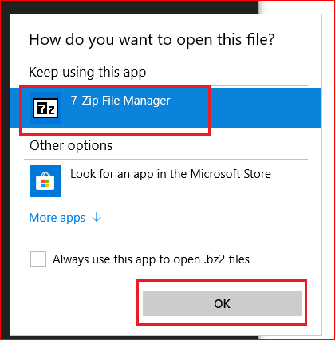

Slide 18
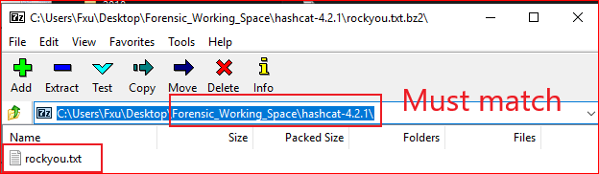
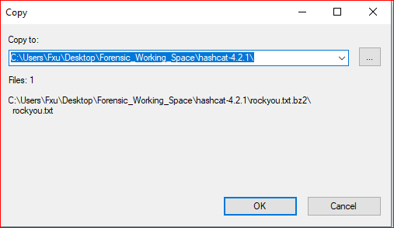

Slide 19
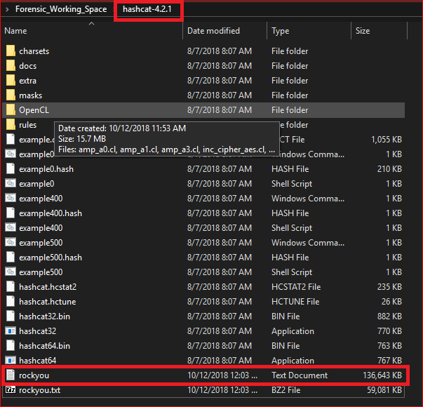
Verify

Slide 20
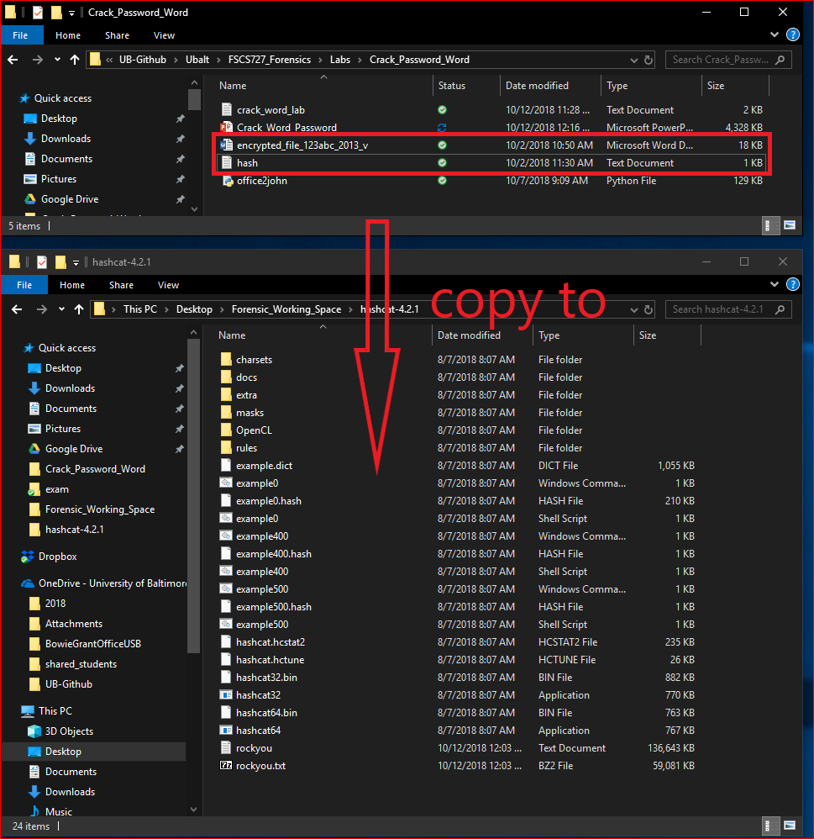

Slide 21
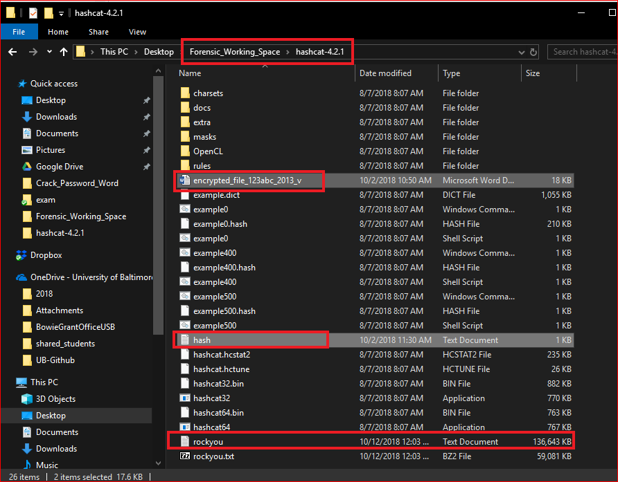

Slide 22
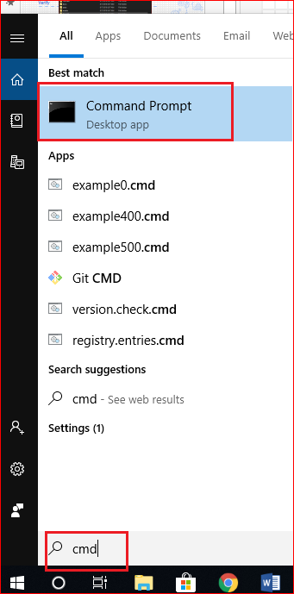
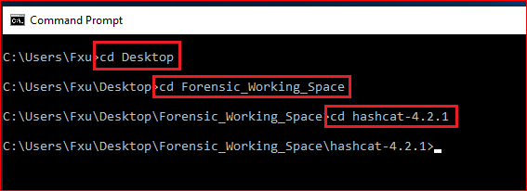

Slide 23
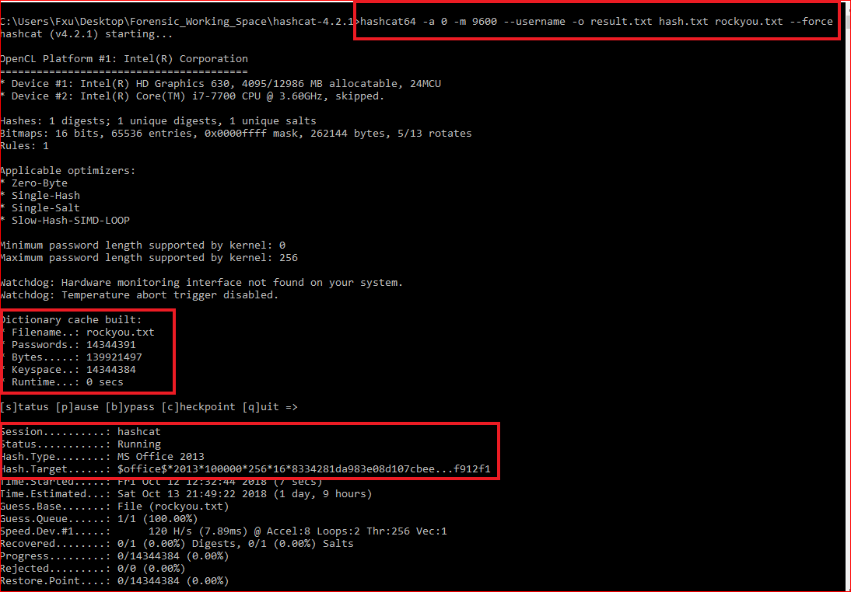
Last step

Slide 24
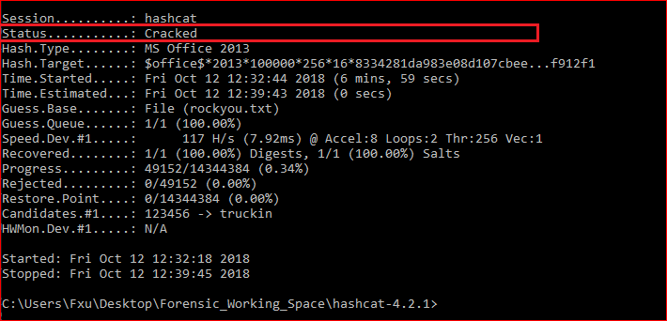

Slide 25
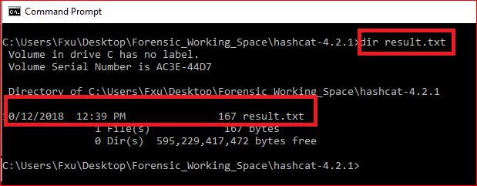
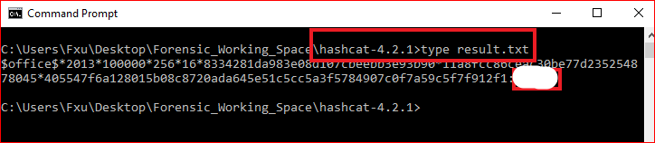

Slide 26
Reference
RC4 tutorial: https://www.youtube.com/watch?v=jjjq41bGzps
https://www.youtube.com/watch?v=lohwg1X0VH8
https://github.com/magnumripper/JohnTheRipper/blob/bleeding-jumbo/run/office2john.py
http://pentestcorner.com/cracking-microsoft-office-97-03-2007-2010-2013-password-hashes-with-hashcat/

Slide 27
Extra credits
https://www.dropbox.com/s/40ak15mk5xr8hvk/how_to_crack_pwd_123.pdf

